Slide 1
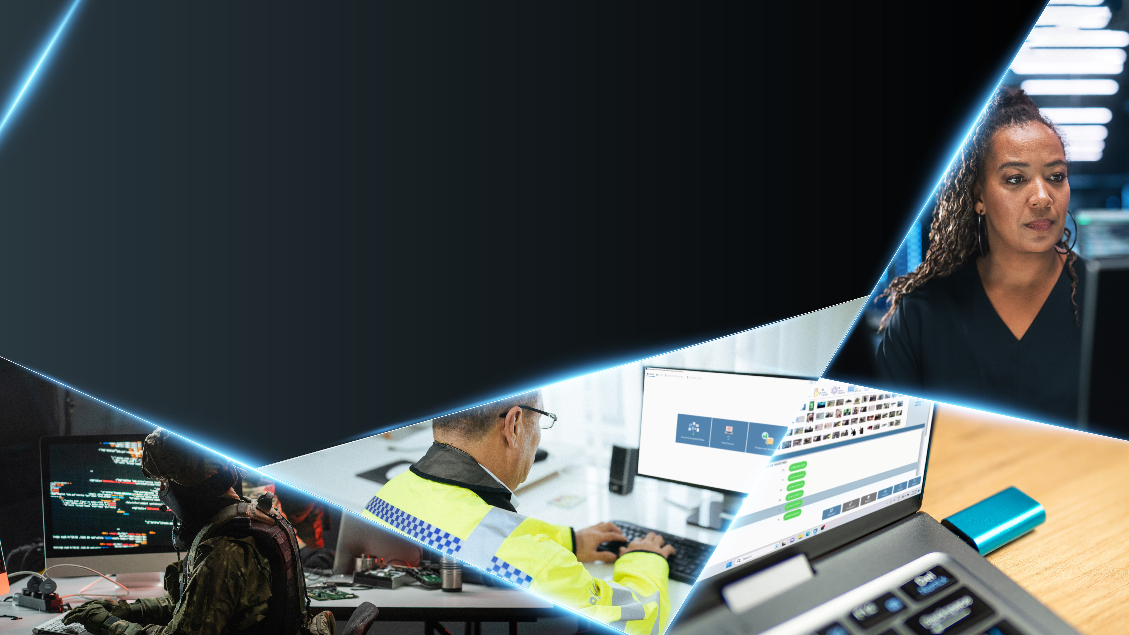
UNIFIED DIGITAL INVESTIGATIONS PLATFORM
IDENTIFY. EXTRACT. ANALYSE. REPORT.
Product and company overview

Slide 2

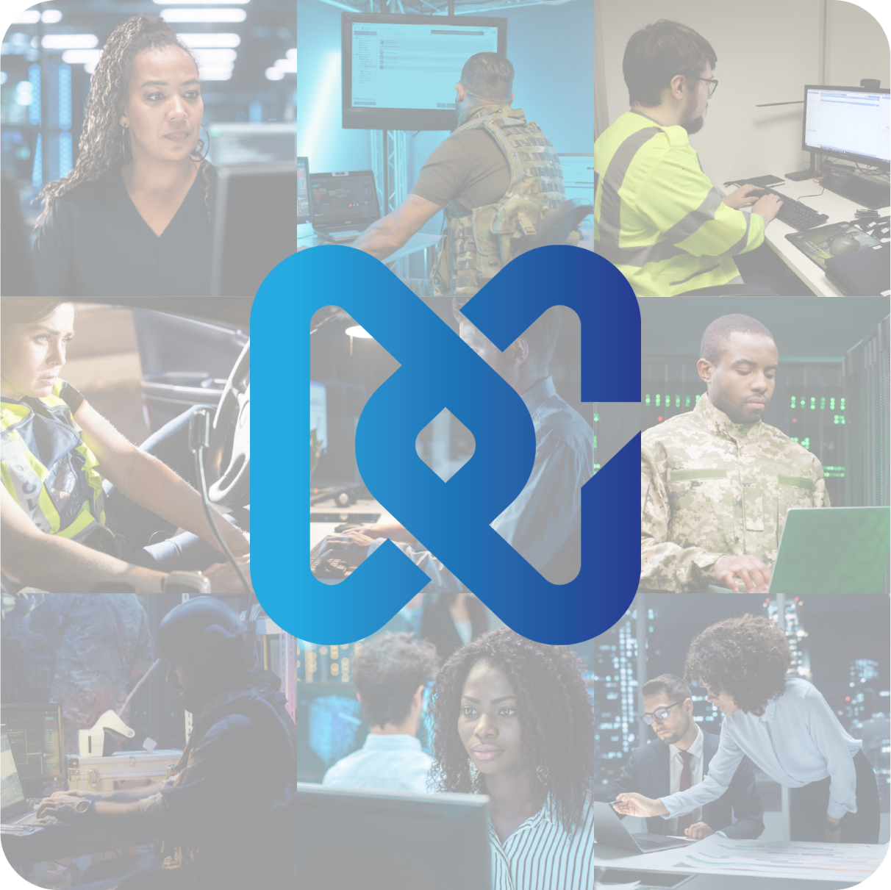
We are Detego global
Helping you solve the security challenges of the 21st century
We are Detego Global, the company behind award-winning Digital Forensics, Case Management, and Endpoint Monitoring solutions that are trusted by the military, law enforcement teams, intelligence agencies, and enterprises around the world.
With the ever-increasing use of digital devices and the corresponding mass of data that’s created, our solutions have become the preferred choice for rapidly acquiring, analysing, and acting on evidence and intelligence.
Trusted by customers in more than 70 countries, our solutions play a crucial role in preventing serious crimes ranging from child abuse and human trafficking to fraud and terrorism.

Slide 3
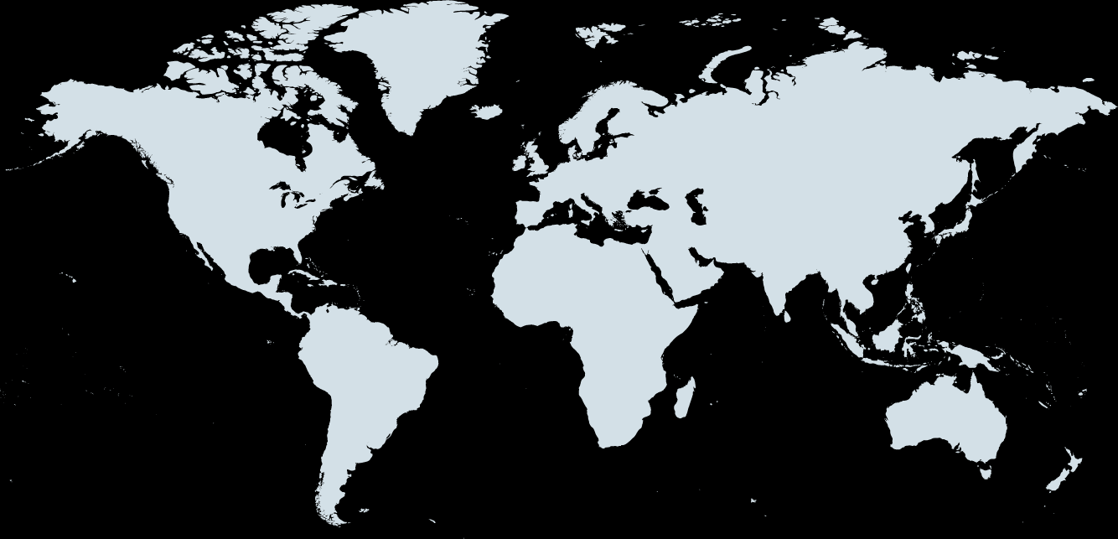

Why choose US?
Experience
Over 20 years’ experience in empowering digital forensics investigations in more than 70 countries..
Personal service, global reach
70+ partners in 36 countries, supported from six locations:
FLEXIBILITY
Built with flexibility at their core, our solutions can be completely tailored to suit the needs, processes, and procedures of any organisation.
1&2
3
5
Globally Patented technology
Patented technology that is trusted by some of the world’s biggest enterprises, elite military units, and law enforcement teams.
6
4
Ease of use
Detego Global’s solutions are highly intuitive and can be used by non-technical members with a minimal training overhead.
London, United Kingdom – Global Headquarters
Horsham, United Kingdom
Delaware, United States
Johannesburg, South Africa
Dubai, United Arab Emirates
Nairobi, Kenya

Slide 4
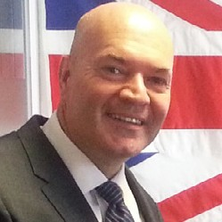

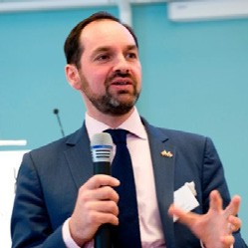
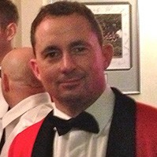
Executive Team
Dave Kirk
Founder
Dave has spent over 30 years in the technology industry designing, developing, and implementing large-scale IT systems. He founded the company in 2003 and has overseen its rapid growth and transformation from a self-funded start-up to a global force in digital technology solutions.
Admiral Lord West
Chairman of the Board
GCB DSC PC ADC, Former First Sea Lord, Minister for Security and Counter-Terrorism, Chief of Defence Intelligence, Commander-in-Chief Fleet, NATO Commander-in-Chief East Atlantic, and NATO Commander Allied Naval Forces North. As Parliamentary Under-Secretary of State at the British Home Office, he was responsible for providing security and counter-terrorism advice to the Prime Minister and Cabinet. Also of note is the fact that he was the UK’s first-ever Cyber Security Minister and was instrumental in developing the UK’s first Cyber Security Strategy.
Oliver Hoare
Non-Executive Director
Oliver was Head of Cyber Security for the London 2012 Olympic and Paralympic Games, responsible for Cyber Security assurance across the games-wide domain, including the UK’s critical national infrastructure and Olympic support networks. More recently, he acted as a consultant for the Tokyo Olympic Games.
Andy Lister
Managing Director
Andy had a military career spanning nearly 20 years, including 10 years in the UK Special Forces. He has vast experience in the full spectrum of direct and sensitive operations. He has been commended by the SO15 Command and other agencies for his contribution to counter-terror policing and Sensitive Site Exploitation (SSE) development. He spent the last four years of his government role as the organisational lead for Digital Media Exploitation (DOMEX) capability which included conventional overt and covert forensics. Nearing a further decade of commercial experience, Andy rapidly moved from special projects to Business Development Director and now leads the great team at Detego Global as Managing Director.

Slide 5













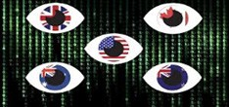




















Our Customers
“
In my many years of examining digital devices, I can boldly say that the Detego software is a tool that all Forensic Examiners should have in their labs.
I would gladly recommend it to my colleagues in other sister agencies.
”

Slide 6
Award-winning digital forensics and incident response SOLUTIONS

Slide 7

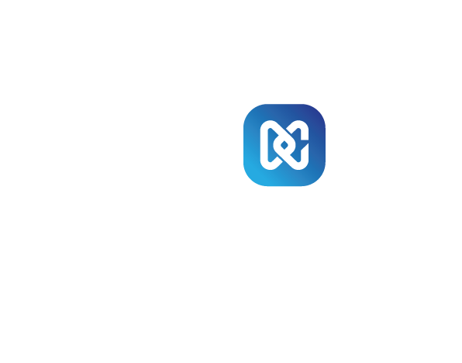
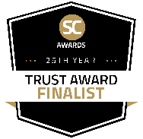
THE WORLD’S FASTEST FORENSIC IMAGING TOOL
Offering forensic imaging speeds 8x faster than the industry average and the ability to get non-technical users fully operational with a 30-minute training session, our globally patented Ballistic Imager tool has become the trusted choice for creating physical images fast.
Forensically secure data from hard disks in minutes
Deploy on computers and laptops running Windows, Mac, or Linux
Swiftly secure data from servers
Achieve blisteringly fast data capture speeds by splitting the imaging process using multiple collectors and utilise all available ports
Extract data in live or boot environments
Benefit from MD5, SHA1, and SHA256 validation
Stop extractions before completion without losing data
Recover deleted data
Deploy without removing hard drives from target devices
Rapidly extract RAM data for comprehensive forensic analysis
Present captured data as an E01, DD, or Ex01 image
Enjoy greater mobility thanks to its portable and compact design
EXTRACT 1TB IN LESS THAN 5 MINUTES
Patented Technology
FINALIST - THE SC AWARD FOR THE BEST COMPUTER FORENSIC SOLUTION

Slide 8

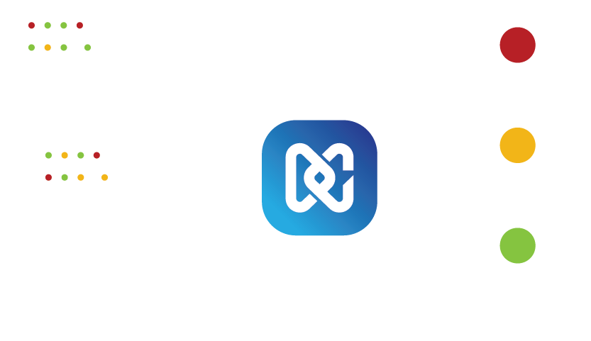

RAPID DIGITAL FORENSICS, ANYWHERE
Field Triage is a highly portable solution, perfect for investigating data on computers, laptops, servers, and loose media. Field Triage uses keywords and hash-matching technology to swiftly identify and alert users about data related to investigations without running time-consuming extractions and analytical processes.
Field Triage enables users to make quick decisions, thanks to its patented red-amber-green visual alert system.
Deploy it anywhere using a removable storage device or external hard drive
Rapidly acquire usernames and passwords and swiftly identify data that’s critical to investigations
Effortlessly customise it for use across a range of investigation types, including modern slavery, fraud, insider trading, harassment, Indecent Images Of Children (IIOC), Internet Crimes Against Children (ICAC), human trafficking, and terrorism
Speed up investigations by leveraging its advanced automation capabilities
Accelerate evidence discovery with the new Xpress HashScan mode, delivering speeds 6x faster for pictures and videos, and 3x faster for all file types
Use data from the Child Abuse Image Database (CAID) and Project VIC to fast-track IIOC, CSAM, and ICAC investigations
Get users up and running in minutes with its simple, easy-to-use interface that’s ideal for non-technical users
SWIFT, AUTOMATED TRIAGE FOR TIME-CRITICAL INVESTIGATIONS
Patented Technology
WINNER - THE SECURITY AND POLICING INNOVATION AWARD IN DIGITAL FORENSICS

Slide 9

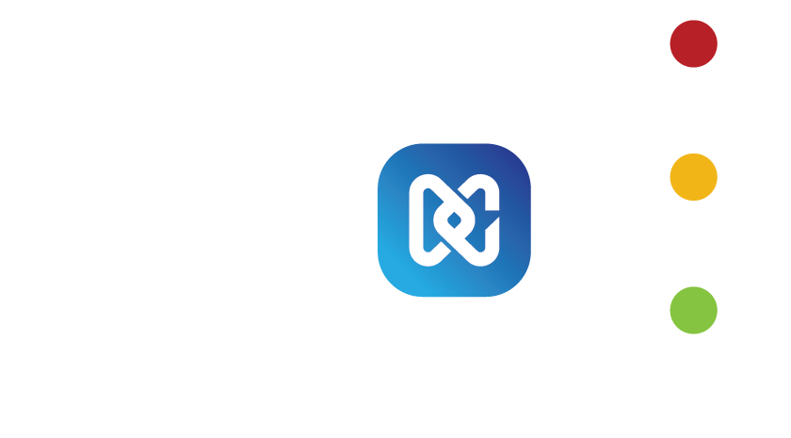

RAPID, AUTOMATED DATA ACQUISITION
Explore Media Acquisition from Detego Global, a solution that automates digital data capture from removable media, mobile devices, computers, drones, and hard drives.
Media Acquisition’s simple, intuitive interface allows users to quickly analyse multiple devices and make on-the-spot decisions by providing live views of the data being captured.
Simultaneously secure and analyse data from multiple removable devices
Use advanced inspection tools to view a target’s file tree before extraction
Get live views of logical data as it streams into the platform
Recover deleted data with powerful carving tools
Acquire data from hard drives removed from damaged systems
Receive automated alerts about suspicious data with the patented red-amber-green visual alert system
Automate analytics with predefined criteria
AUTOMATED, SIMULTANEOUS DATA CAPTURE FROM MULTIPLE DEVICES
FINALIST - THE SC AWARD FOR THE BEST COMPUTER FORENSIC SOLUTION

Slide 10

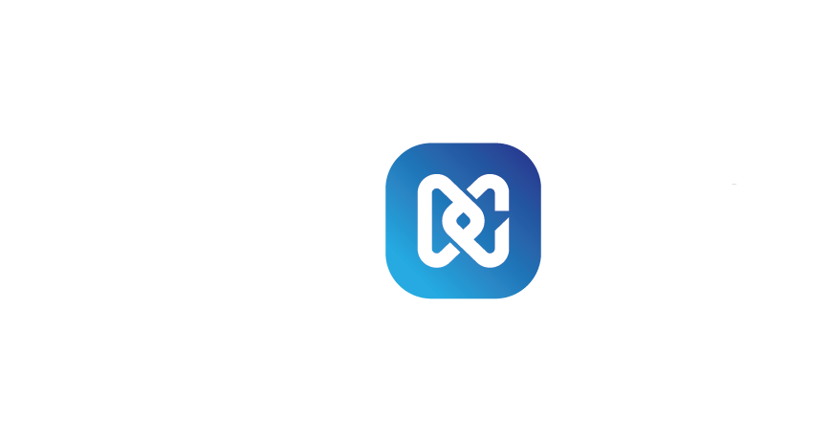
SEAMLESS DATA ACQUISITION FROM THOUSANDS OF MOBILE PHONES, AND A RANGE OF SMART DEVICES AND APPS
Detego MD combines GMDSOFT’s leading data extraction and decryption capability with Detego Analyse AI+’s robust analytics, automation, and reporting functionality. Detego MD enables users to forensically secure and analyse data from tens of thousands of phones (including branded and non-brand mobiles, smartphones, and feature phones), more than 2,000 apps, JTAG boards, SIM cards, drones, and smart, IoT-enabled devices.
Easily access and acquire data from thousands of mobile devices running Android, Apple iOS, Windows, Blackberry OS, Tizen OS, and more
Choose from a range of extraction options including physical and logical extractions, bootloader, Android Debug Bridge (ADB), bypassing, backups, and others
Benefit from iOS support, including backup file decryption and keychain extraction
Deliver greater privacy and enjoy enhanced compliance by carrying out selective extractions of partitions, files, categories, and apps
Extract and analyse data from non-brand devices and burner phones
Use MD-READER/MD-BOX to carry out chip-off and JTAG extractions
Extract and analyse data from drones, including DJI (Phantom, Mavic), Parrot, and PixHawk
Forensically secure and review data from 2,000+ social media, navigation, health, lifestyle, banking, and messaging apps (including WhatsApp, Telegram, Facebook Messenger, WeChat, Snapchat, Line, Signal, KakaoTalk, and more)
SWIFT DATA EXTRACTION FROM MOBILE PHONES, SMART DEVICES, AND MORE

Slide 11


RAPID MOBILE FORENSICS, ANYWHERE
Level up your on-scene investigations with MD-LIVE. This highly portable solution enables users to swiftly access critical data from smartphones and perform logical extractions in any setting.
MD-LIVE will enable you to retrieve recently deleted messages and remotely control device screens. Use it to capture real-time evidence from phones and tablets and keep investigations moving.
Carry out logical extractions and access information critical to investigations on any smartphone
Focus only on the data that matters by conducting selective extractions
Gain external control of devices with screen mirroring to gather data from devices with broken/non-functional displays
Analyse cases faster by viewing data as it would appear on the device
Tap into the inbuilt Omniviewer to preview photos, videos, documents, and other exhibit data
Utilise the Chat Scanner feature to find and analyse specific text in messenger app chats
Run Optical Character Recognition (OCR) analysis to pinpoint vital data from screen recordings
Use advanced automation capabilities to speed up investigations
Generate reports in multiple file formats to provide specialist witness documents
CUTTING-EDGE MOBILE TRIAGE FOR THE QUICK ANALYSIS OF EVIDENCE

Slide 12


ACCESS THE CLOUD FOR RAPID, SECURE FORENSICS
Enhance your investigative capabilities with MD-CLOUD, an intuitive solution designed to support a wide range of cloud services.
MD-CLOUD enables investigators to securely access cloud accounts, IoT device data, and web-based evidence, all while preserving the integrity of critical information. With its user-friendly interface and advanced features, MD-CLOUD streamlines investigations for faster and more efficient results.
Access data from popular cloud services, including Google, iCloud, OneDrive, Baidu, and more
Gain specialised support for extractions from popular Asian platforms such as Baidu Cloud (China) and Naver Cloud (Korea)
Swiftly access data from cloud-based email services, including Google, POP3, and IMAP
Easily gather critical data from popular platforms like Facebook, X (Twitter), Tumblr, and the Telegram messaging app
Retrieve IoT device data from AI speakers and smart home equipment using public or private API authentication
Overcome security barriers with support for IDs/passwords, CAPTCHA, two-step security, and credential-based authentication
Perform web captures when APIs are unavailable to ensure comprehensive evidence collection
Monitor acquisitions in real-time
Streamline investigations with pre-categorised ‘Tag’ searches for faster data access
Preview images, videos, documents, and emails with built-in viewers
Ensure evidence integrity using robust hashing algorithms like MD5 and SHA256
Generate detailed reports in multiple formats, including PDF and Excel
SECURE DATA EXTRACTION FROM CLOUD SERVICES, IOT DEVICES, AND THE WEB

Slide 13

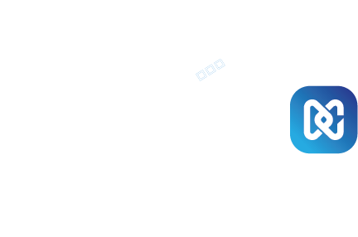
FAST DATA EXTRACTION OVER THE NETWORK
Explore Remote Acquisition, a lightweight solution that leverages our rapid imaging technology to enable fast and secure data extractions over networked environments.
Easily capture crucial system details, RAM contents, user credentials, browser history, cryptocurrency data, and complete physical images from endpoints – all while enjoying the flexibility of resuming extractions from cut-off points in the event of network failures or drops.
Gather data through network agents that can be deployed manually or remotely via Windows Remote Management
Trigger targeted data extractions or create complete physical images directly from Detego Analyse AI+
Remotely extract live RAM data without the need for physical access to the target device
Effortlessly conduct selective extractions by targeting specific user directories, folders, disks, or custom paths
Gain granular control by setting global extraction size limits for logical extractions
Remotely image storage media plugged into networked computers or laptops
ENABLE RAPID IMAGING OVER NETWORKED ENVIRONMENTS

Slide 14

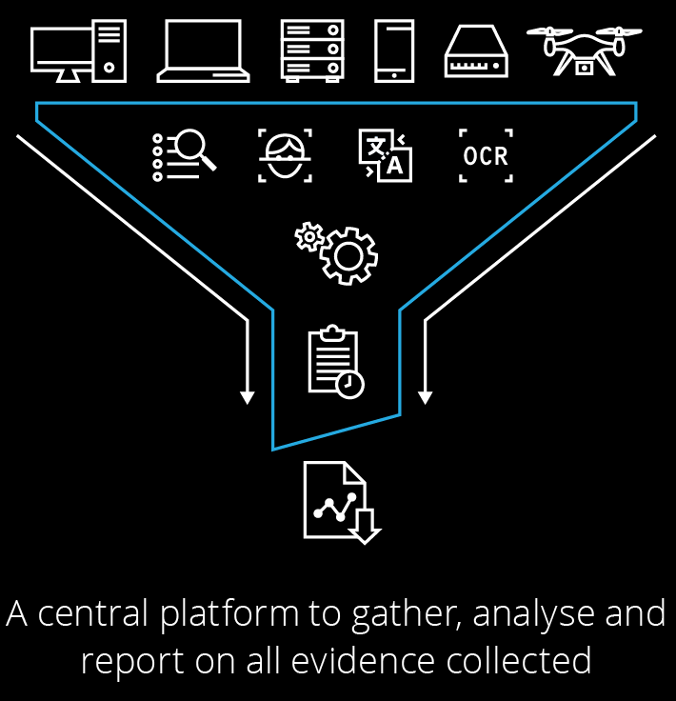
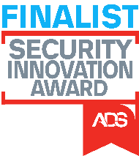
PRODUCE DIGITAL INTELLIGENCE AT SPEED
Detego Analyse AI+ is a powerful analytical platform that integrates forensic acquisitions from Detego solutions and third-party tools, harnessing advanced AI analytics and automation to conduct in-depth analyses, uncover forensic evidence, and generate court-ready reports.
Fast-track evidence discovery with advanced analytical workflows and swift text and keyword matching
Utilise AI-powered face recognition to sift through vast image and video datasets, identifying suspects, witnesses, and persons of interest in seconds (Analyse AI+ detects over 20 faces per second, 4x faster than the industry average)
Instantly detect AI-generated pictures and videos by conducting swift metadata analysis
Minimise manual data sifting with AI-powered semantic search, rapidly identifying broader concepts and contexts such as “distressed children”, “masked men holding weapons at night”, or “screenshots of customer account details”
Leverage AI-powered detection tools to swiftly identify critical content such as weapons, drugs, nudity, indecent images, and more in record time
Match locations and objects with powerful image search tools, using reference images or the “show similar” feature to detect specific signs, symbols, movements, patterns, and designs
Extract text crucial to investigations from pictures and videos with Analyse AI+’s multi-language Optical Character Recognition (OCR) feature
Translate and transcribe audio and video content from 50+ languages to English at speeds exceeding 1,000 words per minute
Run offline document translation to translate text from over 100 languages into English, or conduct cross-language translations
Pinpoint modified images using the Photo DNA matcher, identify altered content or match images with hash values relevant to investigations
Decrypt passwords and access encrypted files in over 300 formats, including Word documents, locked Zip files, phone backups, and more
Uncover hidden files with advanced steganography detection tools
Redact sensitive data across a range of document types including PDFs, DOCX, PPTX, JPG, other popular picture formats, and more
Leverage the all-new Artefact_Compare feature to analyse pre- and post-deployment device snapshots, identify changes, and ensure device security
Perform AI-powered analytical workflows offline, ensuring greater data security
POWERFUL ANALYTICS AND COURT-READY REPORTS
FINALIST - THE UK SECURITY AND POLICING INNOVATION AWARD

Slide 15

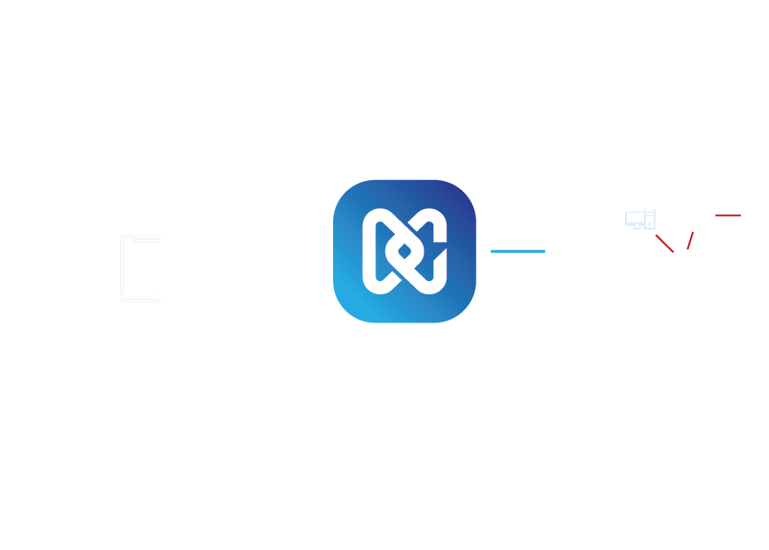
ADVANCED LINK ANALYSIS
Detego Fusion enables investigators to leverage advanced link-building capabilities to expose connections between people, places, devices, and cases.
Connect the dots and expose hidden links across digital exhibits
Access file properties, internet artefacts, communication history (including email addresses, call logs, contacts, messages, and credentials), device information, financial data, keywords, and more to quickly identify and link suspects
Filter data using thousands of preconfigured variables, including GPS coordinates, hash matches, and EXIF data
Instantly view links that exist between cases by using its visual preview functionality
Create custom whitelists to prevent displaying known/approved links
Get users up and running with a minimal training overhead thanks to its intuitive user interface
UNCOVER HIDDEN LINKS WITH AI

Slide 16
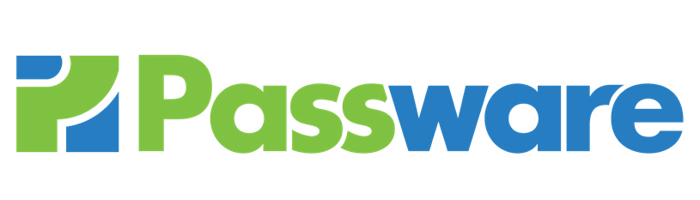

LEVEL UP DECRYPTION CAPABILITIES WITH BOLT-ONS FROM PASSWARE
PASSWARE KIT FORENSIC
This powerful solution is designed to discover and decrypt encrypted evidence, supporting over 370 file types. It detects and reports encrypted files, analyses memory to extract encryption keys and passwords, and acquires memory from Windows, Linux, and Mac devices.
Recover passwords for MS Office, PDF, Zip/RAR, Bitcoin wallets, Apple iTunes Backup, and more
Decrypt leading encryption formats like APFS, BitLocker, FileVault2, TrueCrypt, and VeraCrypt
Streamline investigations with batch processing and a user-friendly interface
PASSWARE KIT MOBILE
Passware Kit Mobile is a cutting-edge mobile forensic tool designed for unlocking and decrypting data from a wide range of Android and iPhone devices, supporting over 900 phone models.
Bypass or recover passcodes by unlocking patterns, passwords, and PINs to extract data from encrypted devices
Process multiple devices simultaneously with its multi-window mode
Decrypt app data by recovering iOS Keychain data, passwords, and data from apps like Signal and Wickr
Accelerate recovery using NVIDIA/AMD GPUs and distributed computing to speed up unlock code recovery
Conduct thorough extractions using full file-system extractions and the retrieval of hardware encryption keys
Benefit from cross-platform support for both Windows and macOS

Slide 17



Partnerships and Integrated Solutions
Headquartered in Seoul, South Korea, GMDSOFT is a leading developer of mobile phone forensic solutions. GMDSOFT’s MD-SERIES has been the go-to solution for hundreds of global investigation agencies since 2005.
Detego Global is GMDSOFT’s exclusive global partner (excluding China), as well as the exclusive distributor of all GMDSOFT MD-SERIES products in the United States, South Africa, and Kenya. Outside of the exclusive territories, Detego Global is also the global distributor of all GMDSOFT MD-SERIES products.
MSAB is a global leader in forensic technology for mobile device examination and analysis to protect lives with software solutions. Their mission is to find the truth and protect the innocent by using products developed in conjunction with the EU FORMOBILE standard project.
MSAB has been involved in mobile communications since 1984 and has focused on mobile forensics and mobile data extraction since 2003. MSAB serves law enforcement agencies, prisons/correctional institutions, intelligence agencies, tax authorities, border control agencies, the military, and selected private companies.
Detego Global has partnered with Project VIC for close to five years to create a safer world for children. We've integrated support for Project VIC hashes to accelerate the detection of millions of known child sexual abuse material. Law enforcement teams leverage this technology to fast-track the identification of victims and bring perpetrators to justice.
Detego Global has partnered with Passware, Inc to fully integrate its industry-leading solution into the Detego Unified Digital Forensics Platform. This allows users to seamlessly identify encrypted evidence, and recover and crack passwords from 300+ file types. Not only can Detego automatically identify every encrypted and password-protected file or folder on an exhibit, it can also effortlessly gain access in a matter of seconds.

Slide 18
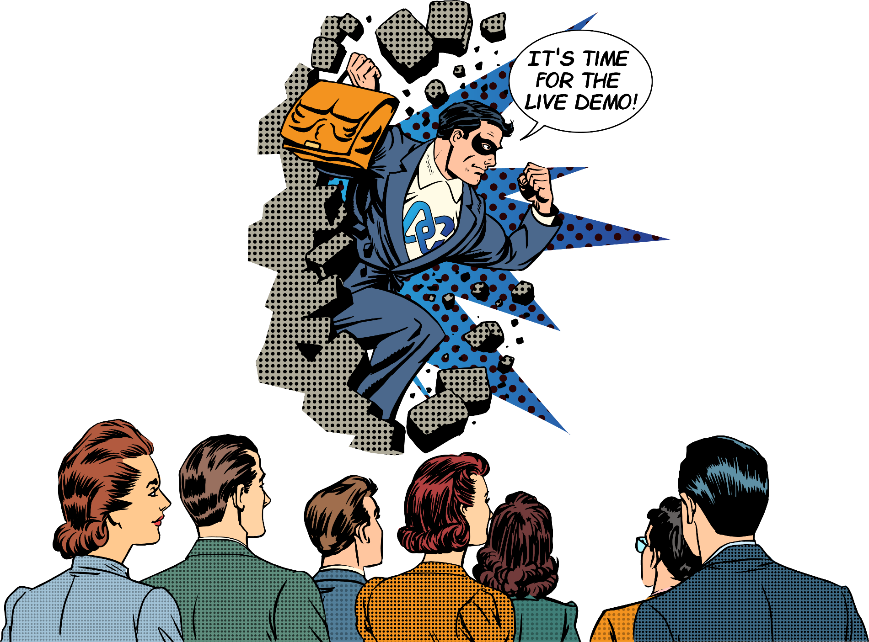
See these solutions in action

Slide 19
What our customers say
“
Like any other Law Enforcement Agency, we were falling behind and failing in overwhelming backlogs. We were able to leverage the speed, ease-of-use and capabilities that Detego has to reimagine and refine our process to become successful and increase our services.
Detego increased our efficiency, provided a multiplatform solution and saved our agency tens of thousands of dollars in manpower, licenses, and equipment.
Sergeant, Special Operations Division, Nebraska State Patrol
”

Slide 20
What our customers say
“
Thanks to the minimal training overhead of Ballistic imager and Field Triage kits, field teams were able to easily gather critical evidence in time-critical situations.
Detego Field triage and Ballistic Imager are solid tools for tactical media exploitation that are also very user friendly.
Member, Swedish MOD Exploitation Unit
”

Slide 21
What our customers say
“
The capability and usability provided by Detego uniquely fits our needs as a forward-leaning Military unit. We had several complex issues & capability gaps, which they have plugged and are helping to continually improve on. The full deployment pack has enabled a simple single source for procurement and is a quantum leap forward in our Digital Exploit capability.
MOD Special Operations Senior Subject Matter Expert
”

Slide 22
What our customers say
“
I just wanted to pass some news on to you. I went out to a search warrant this morning and did our first deployment of Detego on our suspect’s up-and-running computer.
Not only did I find the material needed, but it pulled the username and passwords matching the cyber tip in no time at all. Thank you again for your help through purchasing and training. I think we will be using this tool for quite some time.
Chief Forensic Investigator, Internet Crimes Against Children Taskforce
”

Slide 23


